Slide 1
Calculating Empirical and Molecular Formulas

Slide 2
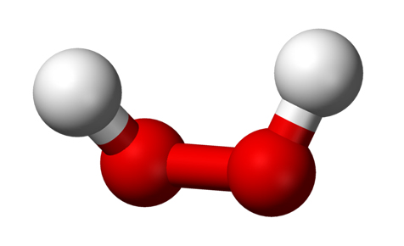
Empirical vs. Molecular Formulas
Empirical Formula
A formula for a compound that gives the smallest whole-number ratio of each type of atom
Molecular Formula
A formula for a compound that gives the specific number of each type of atom in a molecule
Empirical Formula:
HO
Molecular Formula:
H2O2

Slide 3
Calculating Empirical Formula
Example:
Suppose we decompose a sample of hydrogen and oxygen in the laboratory and find that it produces 3.0 grams of hydrogen and 24 grams of oxygen. Calculate the empirical formula?
$$Moles H=3.0 g H × \frac{1 mol H}{1.01 g H}=3.0 mol H$$
$$Moles O=24.0 g O × \frac{1 mol O}{16.00 g O}=1.5 mol O$$
$H_{3}O_{1.5}$ = $H_{2}O$

Slide 4
Your Turn
A compound contains nitrogen and oxygen is decomposed in the laboratory and produces 24.5 grams of nitrogen and 70.0 grams of oxygen. Calculate the empirical formula of the compound.

Slide 5
Calculating Molecular Formulas
Molecular Formula = Empirical formula x n
n = 1, 2, 3 …
Example:
What is the molecular formula for fructose from its empirical formula, CH2O, and its molar mass, 180.2 g/mol.
To find n:
$n=\frac{Molar Mass}{Empirical Formula Molar Mass}$
$n= \frac{180.2 g/mol}{1\left(12.01\right)+2 \left(1.01\right)+16.00}$
n = 6
$$CH_{2}O x 6= C_{6}H_{12}O_{6}$$

